Slide 1
Application of linear programming for profit maximization
BME Capstone project
Domagoj Bekavac Zagreb School of Economics and Management, Business Mathematics and Economics BME Capstone 2020/21 Zagreb, Croatia Dbekavac@student.zsem.hr

Slide 2
Introduction
Goal of every company – develop strategic management plans in order to earn profit
Linear programming – finding an optimal solution (maximization/minimization of the objective function), when there are variety of resource constraints
Real life problems -> mathematical models

Slide 3
Aim of problem research
Operational research
Aim – achieving best performance with given variables and constraints using mathematical optimization
Steps:
Identifying a problem that needs to be solved.
Constructing a model around the problem that resembles the real world and variables.
Using the model to derive solutions to the problem.
Testing each solution on the model and analyzing its success.
Implementing the solution to the actual problem.

Slide 4
Existing methods
Methods for solving:
Graphical method – for 2 decision variables
Simplex method – for more than 2 decision variables
Example: The assignment problem
Hungarian method
Alternate

Slide 5
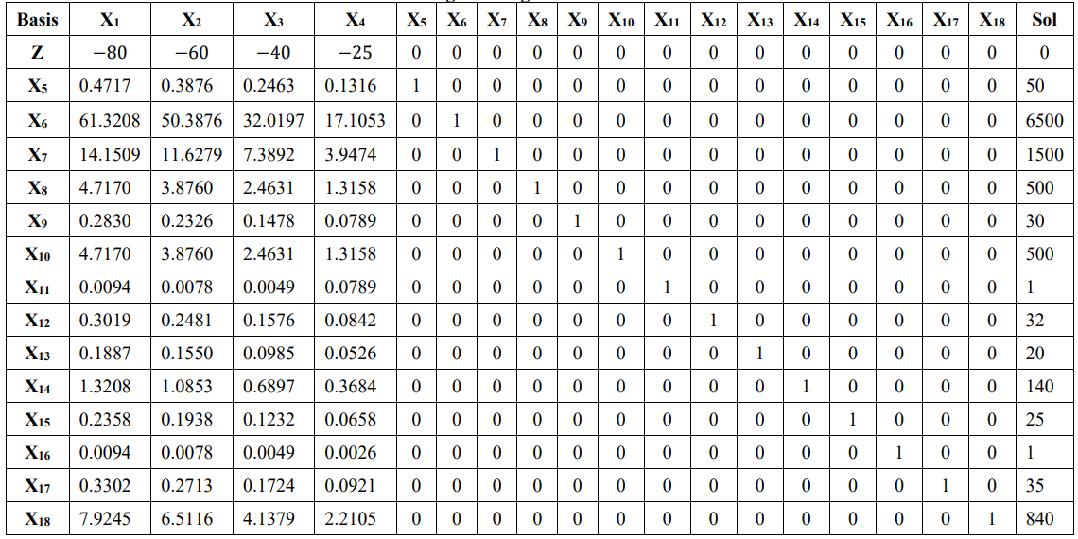
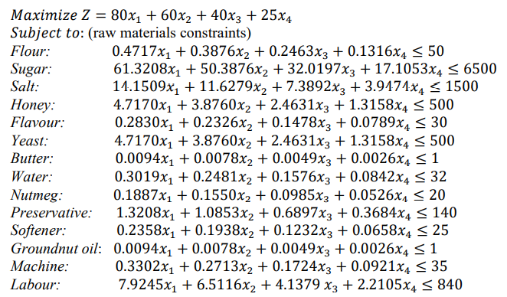
Related work
On the Use of Linear Programming Model Approach in Profit Optimization of a Product Mix Company
(Garba M. K., Banjoko A. W., Yahya W. B. and Gatta N. F. Department of Statistics, University of Ilorin, Nigeria)
Data - Fortunate Bakery, Ilorin, Nigeria
Solution:
Objective function(z) = 9498.4802 (approximately 9500)
Variables = 0,0,0,379.94
Explanation: In order for bakery to maximize profit they need to make approximately 380 units
of product 4 and 0 units of products 1, 2 and 3 on daily basis.

Slide 6
Related work
APPLICATION OF LINEAR PROGRAMMING FOR PROFIT MAXIMIZATION OF A PHARMA COMPANY by Amit Kumar Jain, Hemlata Saxena, Ramakant Bhardwaj, G. V.V. Jagannadha Rao,Ch. Siddharth Nanda (India)
Minimal cost calculation
OPTIMIZING PROFIT WITH THE LINEAR PROGRAMMING MODEL ON SMALL SCALE BUSINESS IN TARABA STATE By Danjuma, Habiba Department of Statistics, Federal Polytechnic Bali, Bali, Taraba State

Slide 7
Problem
Problem solution:
Examining data
Constructing table
Finding optimal solution
Collecting of data:
From bakery Horvat, Veliko Trgovišće
Methods:
Elementary row operations
Solver
Jupyter Notebook (Python)

Slide 8
Problem (Dataset)
 |  | Price(Kn) | weight(kg)
X1 | Bread | 6 | 0.7
X2 | Small bagel | 2.5 | 0.06
X3 | Large bagel | 3 | 0.12
X4 | Chocolate donut | 4 | 0.12
X5 | Chocolate croissant | 4 | 0.14
X6 | Pizza ham and cheese | 8 | 0.25
X7 | Ham and cheese sandwich | 5 | 0.17
X8 | Hot dog with cheese | 7 | 0.2
X | Products | Price (Kn) | Cost (Kn) | Profit (Kn)
X1 | Bread | 6 | 1.29 | 4.71
X2 | Small bagel | 2.5 | 0.11 | 2.39
X3 | Large bagel | 3 | 0.23 | 2.77
X4 | Chocolate donut | 4 | 1.61 | 2.39
X5 | Chocolate croissant | 4 | 2.01 | 1.99
X6 | Pizza ham and cheese | 8 | 2.65 | 5.35
X7 | Sandwich ham and cheese | 5 | 1.56 | 3.44
X8 | Hot dog with cheese | 7 | 1.51 | 5.49

Slide 9
Problem (Dataset)
raw materials/products | bread | small bagel | large bagel | chocolate donut | Chocolate croissant | Pizza ham and cheese | Sandwich ham and cheese | Hot dog with cheese
flour(kg) | 0.5 | 0.042 | 0.084 | 0.055 | 0.058 | 0.1 | 0.084 | 0.084
water(l) | 0.3 | 0.025 | 0.05 | 0.03 | 0.032 | 0.06 | 0.05 | 0.05
salt(kg) | 0.01 | 0.0008 | 0.0016 | 0.0008 | 0.0008 | 0.003 | 0.0016 | 0.0016
sugar(kg) | 0 | 0 | 0 | 0.001 | 0.0008 | 0 | 0 | 0
yeast(kg) | 0.01 | 0.0008 | 0.0016 | 0.001 | 0.001 | 0.002 | 0.0016 | 0.0016
sunflower oil(l) | 0 | 0.00025 | 0.0005 | 0.008 | 0.007 | 0.0007 | 0.0005 | 0.0005
butter(kg) | 0 | 0.00025 | 0.0005 | 0.0006 | 0.0008 | 0.0005 | 0.0005 | 0.0005
eggs | 0 | 0 | 0 | 0.25 | 0.25 | 0 | 0 | 0
chocolate(kg) | 0 | 0 | 0 | 0.03 | 0.04 | 0 | 0 | 0
ham(kg) | 0 | 0 | 0 | 0 | 0 | 0.04 | 0.025 | 0
cheese(kg) | 0 | 0 | 0 | 0 | 0 | 0.04 | 0.025 | 0.025
tomato sauce(l) | 0 | 0 | 0 | 0 | 0 | 0.025 | 0 | 0
oregano(kg) | 0 | 0 | 0 | 0 | 0 | 0.0002 | 0 | 0
hot dog | 0 | 0 | 0 | 0 | 0 | 0 | 0 | 0.04
mustard(l) | 0 | 0 | 0 | 0 | 0 | 0 | 0 | 0.015
raw materials | max | price per kg/l/peace
flour(kg) | 3450 | 2.30
water(l)
salt(kg) | 70 | 4.20
sugar(kg) | 5 | 4.40
yeast(kg) | 70 | 9.90
sunflower oil(l) | 20 | 7.20
butter(kg) | 6 | 14.98
eggs | 400 | 0.80
chocolate(kg) | 55 | 40.00
ham(kg) | 100 | 18.89
cheese(kg) | 120 | 34.49
tomato sauce(l) | 40 | 7.00
oregano(kg) | 0.5 | 300.00
hot dog | 40 | 1.99
mustard(l) | 15 | 22.70

Slide 10
Problem (objective function and constraints)
Objective function : MAX(4.71 * x1 + 2.39 * x2 + 2.77 * x3 + 2.39 * x4 + 1.99 * x5 + 5.35 * x6 + 3.44 * x7 + 5.49 * x8)
Constraints:
0.5 * x1 + 0.042 * x2 + 0.084 * x3 + 0.055 * x4 + 0.058 * x5 + 0.1 * x6 + 0.084 * x7 + 0.084 * x8 <= 3450
0.3 * x1 + 0.025 * x2 + 0.05 * x3 + 0.03 * x4 + 0.032 * x5 + 0.06 * x6 + 0.05 * x7 + 0.05 * x8 <= 10000
0.01 * x1 + 0.0008 * x2 + 0.0016 * x3 + 0.0008 * x4 + 0.0008 * x5 + 0.003 * x6 + 0.0016 * x7 + 0.0016 * x8 <= 70
0.001 * x4 + 0.0008 * x5 <= 5
0.01 * x1 + 0.0008 * x2 + 0.0016 * x3 + 0.001 * x4 + 0.001 * x5 + 0.002 * x6 + 0.0016 * x7 + 0.0016 * x8 <= 70
0.00025 * x2 + 0.0005 * x3 + 0.008 * x4 + 0.007 * x5 + 0.0007 * x6 + 0.0005 * x7 + 0.0005 * x8 <= 20
0.00025 * x2 + 0.0005 * x3 + 0.0006 * x4 + 0.0008 * x5 + 0.0005 * x6 + 0.0005 * x7 + 0.0005 * x8 <= 6
0.25 * x4 + 0.25 * x5 <= 400
0.03 * x4 + 0.04 * x5 <= 55
0.04 * x6 + 0.025 * x7 <= 100
0.04 * x6 + 0.025 * x7 + 0.025 * x8 <= 120
0.025 * x6 <= 40
0.0002 * x6 <= 0.5
0.04 * x8 <= 40
0.015 * x8 <= 15

Slide 11
Problem (Methods) 1. elementary row operations
B | Cb | P | x₁ | x₂ | x₃ | x₄ | x₅ | x₆ | x₇ | x₈↓ | x₉ | x₁₀ | x₁₁ | x₁₂ | x₁₃ | x₁₄ | x₁₅ | x₁₆ | x₁₇ | x₁₈ | x₁₉ | x₂₀ | x₂₁ | x₂₂ | x₂₃ | Q
 |  |  | 4.71 | 2.39 | 2.77 | 2.39 | 1.99 | 5.35 | 3.44 | 5.49 | 0 | 0 | 0 | 0 | 0 | 0 | 0 | 0 | 0 | 0 | 0 | 0 | 0 | 0 | 0
x₉ | 0 | 3450 | 0.5 | 0.04 | 0.08 | 0.06 | 0.06 | 0.1 | 0.08 | 0.08 | 1 | 0 | 0 | 0 | 0 | 0 | 0 | 0 | 0 | 0 | 0 | 0 | 0 | 0 | 0 | 41071.43
x₁₀ | 0 | 10000 | 0.3 | 0.03 | 0.05 | 0.03 | 0.03 | 0.06 | 0.05 | 0.05 | 0 | 1 | 0 | 0 | 0 | 0 | 0 | 0 | 0 | 0 | 0 | 0 | 0 | 0 | 0 | 200000
x₁₁ | 0 | 70 | 0.01 | 0.0008 | 0.002 | 0.0008 | 0.0008 | 0.003 | 0.002 | 00.002 | 0 | 0 | 1 | 0 | 0 | 0 | 0 | 0 | 0 | 0 | 0 | 0 | 0 | 0 | 0 | 43750
x₁₂ | 0 | 5 | 0 | 0 | 0 | 0 | 0.0008 | 0 | 0 | 0 | 0 | 0 | 0 | 1 | 0 | 0 | 0 | 0 | 0 | 0 | 0 | 0 | 0 | 0 | 0 | ∞
x₁₃ | 0 | 70 | 0.01 | 0.0008 | 0.002 | 0.001 | 0.001 | 0.002 | 0.002 | 0.002 | 0 | 0 | 0 | 0 | 1 | 0 | 0 | 0 | 0 | 0 | 0 | 0 | 0 | 0 | 0 | 43750
x₁₄ | 0 | 20 | 0.0003 | 0.0005 | 0.008 | 0.01 | 0.01 | 0.0007 | 0.0005 | 0.0005 | 0 | 0 | 0 | 0 | 0 | 1 | 0 | 0 | 0 | 0 | 0 | 0 | 0 | 0 | 0 | 40000
x₁₅ | 0 | 6 | 0.0003 | 0.0005 | 0.0006 | 0.0008 | 0.0005 | 0.0005 | 0.0005 | 0.0005 | 0 | 0 | 0 | 0 | 0 | 0 | 1 | 0 | 0 | 0 | 0 | 0 | 0 | 0 | 0 | 12000
x₁₆ | 0 | 400 | 0 | 0 | 0 | 0.25 | 0.25 | 0 | 0 | 0 | 0 | 0 | 0 | 0 | 0 | 0 | 0 | 1 | 0 | 0 | 0 | 0 | 0 | 0 | 0 | ∞
x₁₇ | 0 | 55 | 0 | 0 | 0 | 0.03 | 0.04 | 0 | 0 | 0 | 0 | 0 | 0 | 0 | 0 | 0 | 0 | 0 | 1 | 0 | 0 | 0 | 0 | 0 | 0 | ∞
x₁₈ | 0 | 100 | 0 | 0 | 0 | 0 | 0 | 0.04 | 0.03 | 0 | 0 | 0 | 0 | 0 | 0 | 0 | 0 | 0 | 0 | 1 | 0 | 0 | 0 | 0 | 0 | ∞
x₁₉ | 0 | 120 | 0 | 0 | 0 | 0 | 0 | 0.04 | 0.025 | 0.025 | 0 | 0 | 0 | 0 | 0 | 0 | 0 | 0 | 0 | 0 | 1 | 0 | 0 | 0 | 0 | 4800
x₂₀ | 0 | 40 | 0 | 0 | 0 | 0 | 0 | 0.025 | 0 | 0 | 0 | 0 | 0 | 0 | 0 | 0 | 0 | 0 | 0 | 0 | 0 | 1 | 0 | 0 | 0 | ∞
x₂₁ | 0 | 0.5 | 0 | 0 | 0 | 0 | 0 | 0.0002 | 0 | 0 | 0 | 0 | 0 | 0 | 0 | 0 | 0 | 0 | 0 | 0 | 0 | 0 | 1 | 0 | 0 | ∞
x₂₂ | 0 | 40 | 0 | 0 | 0 | 0 | 0 | 0 | 0 | 0.04 | 0 | 0 | 0 | 0 | 0 | 0 | 0 | 0 | 0 | 0 | 0 | 0 | 0 | 1 | 0 | 1000
←
x₂₃ | 0 | 15 | 0 | 0 | 0 | 0 | 0 | 0 | 0 | 0.015 | 0 | 0 | 0 | 0 | 0 | 0 | 0 | 0 | 0 | 0 | 0 | 0 | 0 | 0 | 1 | 1000
max |  | 0 | -4.71 | -2.39 | -2.77 | -2.39 | -1.99 | -5.35 | -3.44 | -5.49 | 0 | 0 | 0 | 0 | 0 | 0 | 0 | 0 | 0 | 0 | 0 | 0 | 0 | 0 | 0

Slide 12
Problem (Methods) 1. elementary row operations
B | Cb | P | x₁ | x₂ | x₃ | x₄ | x₅ | x₆ | x₇ | x₈ | x₉ | x₁₀ | x₁₁ | x₁₂ | x₁₃ | x₁₄ | x₁₅ | x₁₆ | x₁₇ | x₁₈ | x₁₉ | x₂₀ | x₂₁ | x₂₂ | x₂₃ | Q
 |  |  | 4.71 | 2.39 | 2.77 | 2.39 | 1.99 | 5.35 | 3.44 | 5.49 | 0 | 0 | 0 | 0 | 0 | 0 | 0 | 0 | 0 | 0 | 0 | 0 | 0 | 0 | 0
x₂ | 2.39 | 18800 | 0 | 1 | 2 | 2.4 | 3.2 | 0 | 2 | 0 | 0 | 0 | 0 | 0 | 0 | 0 | 4000 | 0 | 0 | 0 | 0 | -80 | 0 | -50 | 0
x₁₀ | 0 | 7934.16 | 0 | 0 | 0 | 0 | 0 | 0 | 0 | 0 | -0.6 | 1 | 0 | 0 | 0 | 0 | 0.8 | 0 | 0 | 0 | 0 | -0.02 | 0 | 0 | 0
x₁ | 4.71 | 4832 | 1 | 0 | 0 | -0.09 | -0.15 | 0 | 0 | 0 | 2 | 0 | 0 | 0 | 0 | 0 | -336 | 0 | 0 | 0 | 0 | -1.28 | 0 | 0 | 0
x₁₂ | 0 | 5 | 0 | 0 | 0 | 0 | 0 | 0 | 0 | 0 | 0 | 0 | 0 | 1 | 0 | 0 | 0 | 0 | 0 | 0 | 0 | 0 | 0 | 0 | 0
x₁₃ | 0 | 1.83 | 0 | 0 | 0 | 0 | 0 | 0 | 0 | 0 | -0.02 | 0 | 0 | 0 | 1 | 0 | 0.16 | 0 | 0 | 0 | 0 | 0 | 0 | 0 | 0
x₁₄ | 0 | 13.68 | 0 | 0 | 0 | 0.01 | 0.01 | 0 | 0 | 0 | 0 | 0 | 0 | 0 | 0 | 1 | -1 | 0 | 0 | 0 | 0 | -0.01 | 0 | 0 | 0
x₁₁ | 0 | 0.23 | 0 | 0 | 0 | 0 | 0 | 0 | 0 | 0 | -0.02 | 0 | 1 | 0 | 0 | 0 | 0.16 | 0 | 0 | 0 | 0 | -0.04 | 0 | 0 | 0
x₁₆ | 0 | 400 | 0 | 0 | 0 | 0.25 | 0.25 | 0 | 0 | 0 | 0 | 0 | 0 | 0 | 0 | 0 | 0 | 1 | 0 | 0 | 0 | 0 | 0 | 0 | 0
x₁₇ | 0 | 55 | 0 | 0 | 0 | 0.03 | 0.04 | 0 | 0 | 0 | 0 | 0 | 0 | 0 | 0 | 0 | 0 | 0 | 1 | 0 | 0 | 0 | 0 | 0 | 0
x₁₈ | 0 | 36 | 0 | 0 | 0 | 0 | 0 | 0 | 0.03 | 0 | 0 | 0 | 0 | 0 | 0 | 0 | 0 | 0 | 0 | 1 | 0 | -1.6 | 0 | 0 | 0
x₁₉ | 0 | 31 | 0 | 0 | 0 | 0 | 0 | 0 | 0.03 | 0 | 0 | 0 | 0 | 0 | 0 | 0 | 0 | 0 | 0 | 0 | 1 | -1.6 | 0 | -0.62 | 0
x₆ | 5.35 | 1600 | 0 | 0 | 0 | 0 | 0 | 1 | 0 | 0 | 0 | 0 | 0 | 0 | 0 | 0 | 0 | 0 | 0 | 0 | 0 | 40 | 0 | 0 | 0
x₂₁ | 0 | 0.18 | 0 | 0 | 0 | 0 | 0 | 0 | 0 | 0 | 0 | 0 | 0 | 0 | 0 | 0 | 0 | 0 | 0 | 0 | 0 | -0.01 | 1 | 0 | 0
x₈ | 5.49 | 1000 | 0 | 0 | 0 | 0 | 0 | 0 | 0 | 1 | 0 | 0 | 0 | 0 | 0 | 0 | 0 | 0 | 0 | 0 | 0 | 0 | 0 | 25 | 0
x₂₃ | 0 | 0 | 0 | 0 | 0 | 0 | 0 | 0 | 0 | 0 | 0 | 0 | 0 | 0 | 0 | 0 | 0 | 0 | 0 | 0 | 0 | 0 | 0 | -0.38 | 1
max |  | 81740.7 | 0 | 0 | 2.01 | 2.91 | 4.94 | 0 | 1.34 | 0 | 9.42 | 0 | 0 | 0 | 0 | 0 | 7977.44 | 0 | 0 | 0 | 0 | 16.77 | 0 | 17.75 | 0

Slide 13
Problem (Methods) 1. elementary row operations
9 iterations
In order for bakery to maximize their profits, they need to produce 4832 units of bread, 18800 small bagel units, 1600 slices of pizza and 1000 hot dogs.
Other products have 0 by their name, meaning that they are not profitable for the industry, and it is best not to produce them.
Maximum profit amounts 81740.72 Kn monthly.

Slide 14
Problem (Methods) 2. solver
X | Products | Price (Kn) | Cost (Kn) | Profit (Kn) | Quantity
X1 | Bread | 6 | 1.29 | 4.71
X2 | Small bagel | 2.5 | 0.11 | 2.39
X3 | Large bagel | 3 | 0.23 | 2.77
X4 | Chocolate donut | 4 | 1.61 | 2.39
X5 | Chocolate croissant | 4 | 2.01 | 1.99
X6 | Pizza ham and cheese | 8 | 2.65 | 5.35
X7 | Sandwich ham and cheese | 5 | 1.56 | 3.44
X8 | Hot dog with cheese | 7 | 1.51 | 5.49
Objective function | 0
(Maximum profit in Kn)
Number | Constraints |  |  | Max Kg, l, peaces
1 | flour | 0 | <= | 3450
2 | water | 0 | <= | infinite
3 | salt | 0 | <= | 70
4 | sugar | 0 | <= | 5
5 | yeast | 0 | <= | 70
6 | sunflower oil | 0 | <= | 20
7 | butter | 0 | <= | 6
8 | eggs | 0 | <= | 400
9 | chocolate | 0 | <= | 55
10 | ham | 0 | <= | 100
11 | cheese | 0 | <= | 120
12 | tomato sauce | 0 | <= | 40
13 | oregano | 0 | <= | 0.5
14 | hot dog | 0 | <= | 40
15 | mustard | 0 | <= | 15
16 | nonnegativity constraint (X1) | 0 | > | 0 | integer
17 | nonnegativity constraint (X2) | 0 | > | 0 | integer
18 | nonnegativity constraint (X3) | 0 | > | 0 | integer
19 | nonnegativity constraint (X4) | 0 | > | 0 | integer
20 | nonnegativity constraint (X5) | 0 | > | 0 | integer
21 | nonnegativity constraint (X6) | 0 | > | 0 | integer
22 | nonnegativity constraint (X7) | 0 | > | 0 | integer
23 | nonnegativity constraint (X8) | 0 | > | 0 | integer

Slide 15
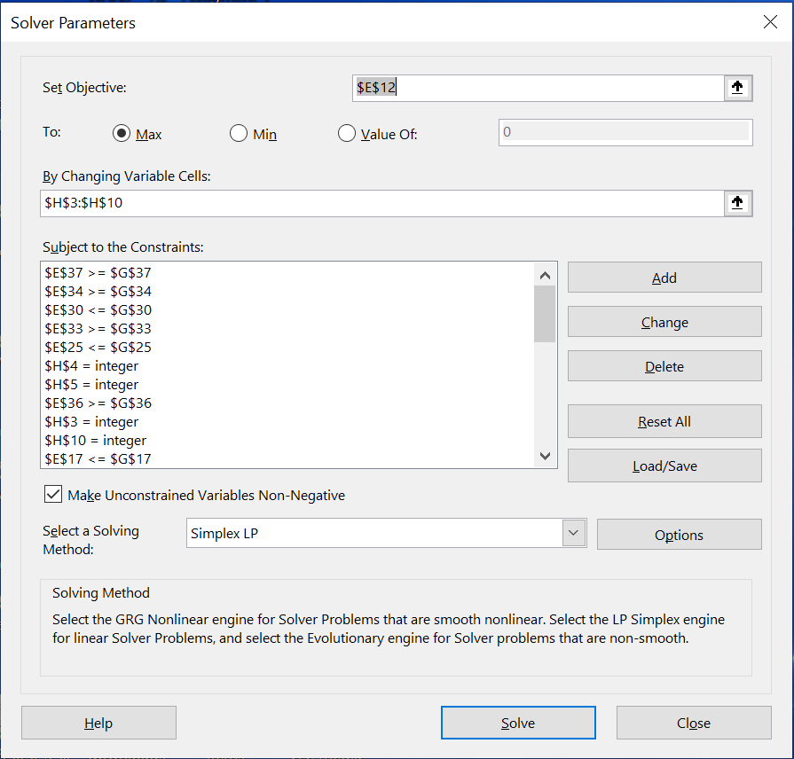
Problem (Methods) 2. solver
X | Products | Price (Kn) | Cost (Kn) | Profit (Kn) | Quantity
X1 | Bread | 6 | 1.29 | 4.71 | 4832
X2 | Small bagel | 2.5 | 0.11 | 2.39 | 18800
X3 | Large bagel | 3 | 0.23 | 2.77 | 0
X4 | Chocolate donut | 4 | 1.61 | 2.39 | 0
X5 | Chocolate croissant | 4 | 2.01 | 1.99 | 0
X6 | Pizza ham and cheese | 8 | 2.65 | 5.35 | 1600
X7 | Sandwich ham and cheese | 5 | 1.56 | 3.44 | 0
X8 | Hot dog with cheese | 7 | 1.51 | 5.49 | 1000
Objective function | 81740.72
(Maximum profit in Kn)

Slide 16
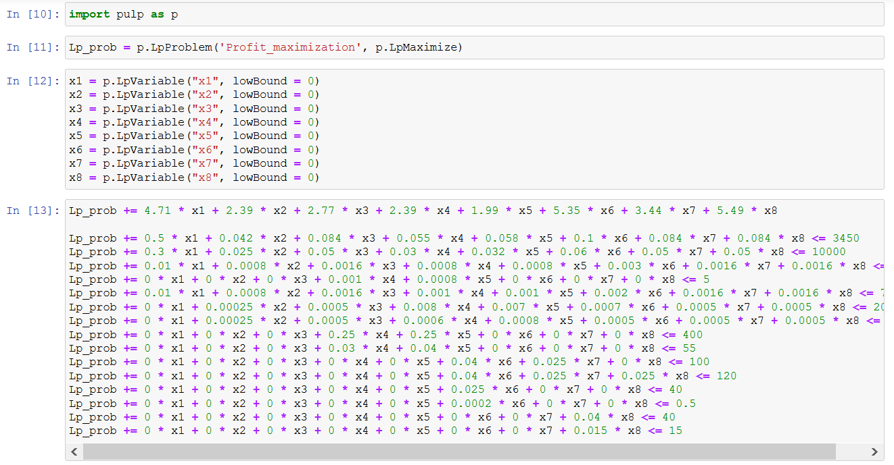
Problem (Methods) 3. Jupyter notebook (python)
print(p.value(x1), p.value(x2), p.value(x3), p.value(x4), p.value(x5), p.value(x6), p.value(x7), p.value(x8), p.value(Lp_prob.objective))
4832.8, 18800, 0, 0, 0, 1600, 0, 1000, 81744.488

Slide 17
literature
https://whatis.techtarget.com/definition/operations-research-OR
https://core.ac.uk/download/pdf/249335256.pdf
https://www.iuiu.ac.ug/journaladmin/iumj/ArticleFiles/79853.pdf, “On the Use of Linear Programming Model Approach in Profit Optimization of a Product Mix Company” Garba M. K., Banjoko A. W., Yahya W. B. and Gatta N. F. Department of Statistics, University of Ilorin, Nigeria, IUMJ, vol. 7 (2), 2020.
http://www.jcreview.com/fulltext/197-1592807730.pdf, “APPLICATION OF LINEAR PROGRAMMING FOR PROFIT MAXIMIZATION OF A PHARMA COMPANY” Amit Kumar Jain, Hemlata Saxena, Ramakant Bhardwaj, G. V.V. Jagannadha Rao,Ch. Siddharth Nanda, India, Vol 7, Issue 12, 2020.
https://www.bakundijournal.com/-/uploads/habiba%20full.pdf, “OPTIMIZING PROFIT WITH THE LINEAR PROGRAMMING MODEL ON SMALL SCALE BUSINESS IN TARABA STATE” Danjuma, Habiba Department of Statistics, Federal Polytechnic Bali, Bali, Taraba State.
https://cs.nyu.edu/~overton/g22_lp/encyc/article_web.html, “Linear Programming”, Michael L. Overton, Draft for Encyclopedia Americana, December 20, 1997.

Slide 18
Thank you for your attention

